Slide 1
Females In Politics
Katie Primrose

Slide 2
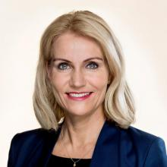
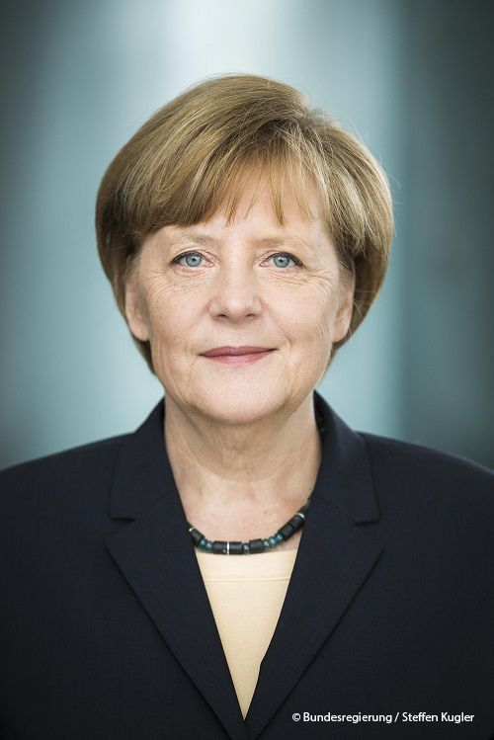
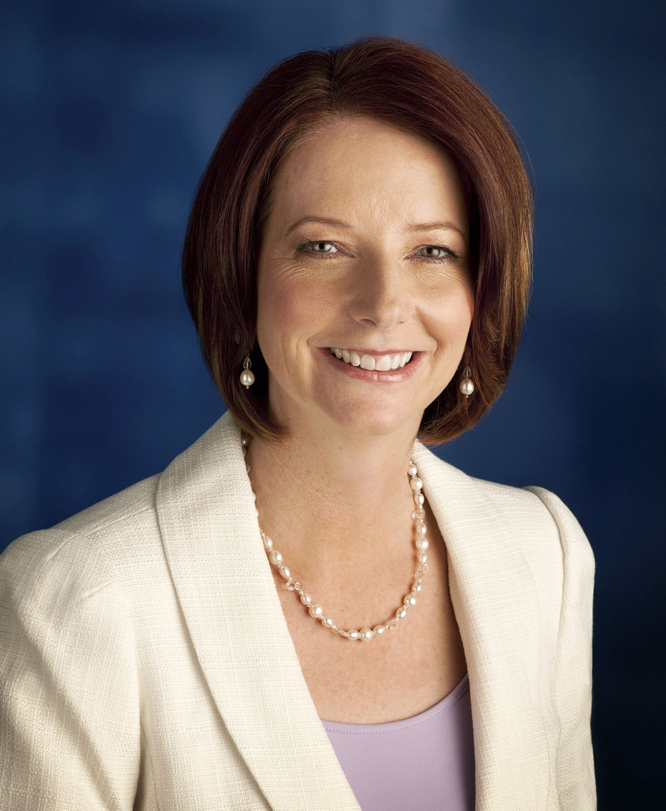
Female Leadership
2016: first female nominee for major political party (presidential)
Only 63 out of 142 nations have had a female government leader
Helle Thorning-Schmidt
Prime Minister for Denmark
Angela Merkel Chancellor of Germany
Julia Gillard Prime Minister of Australia

Slide 3
Voice of a Leader
Vocal qualities:
too shrill/grating, no passion
Choosing words carefully:
wonderful, happy and giddy
Choosing topics carefully:
economics and U.S. jobs

Slide 4
Poll Results
52% white men “Very Unfavorable”
#1 fear of men - becoming subordinate to a woman
Having a female boss, leader etc.
Americans are uncomfortable with female ambition
Advice for female politicians
Not take credit for success
Use informal pictures engaging with community

Slide 5
Fear of Females
Not prepared
Not strong enough
Too emotional
Not ‘fit’ enough
‘Housewife with big dreams’
“42% of America believes it has become too soft and feminine”

Slide 6
‘Hillary Rodham Clinton faced backlash during the 2016 presidential election due to her public appearance, her ability to connect with the audience and the general population’s confidence in her faculties’

Slide 7
sources
“An Address by the Honorable Julia Gillard, the Prime Minister of the Commonwealth of Australia”. Asia Society. N.p., n.d. Web. 15 Apr. 2017.
Beinart, Peter. “Fear of a Female President.” Dispatches, October 2016. Pp 15-17.
CTFORUM. Gloria Steinem on Hillary Clinton and Female Authority. Online video clip. YouTube,
October 18, 2012. Web. April 13, 2017.
Kaufer, David S. and Shawn J. Parry-Guiles. “Hillary Clinton’s Presidential Campaign Memoirs: A
Study in Contrasting Identities.” Quarterly Journal of Speech, vol. 103, no. ½, Feb-May
2017, pp. 7-32. EBSCOhost doi: 10.1080/00335630.22016.1221529
"Our CEO, Helle Thorning-Schmidt." Save the Children International. N.p., n.d. Web. 15 Apr. 2017.
Phillips, Amber. “Analysis Hillary Clinton says ‘misogyny played a role’ in her loss. The
Washington Post. WP company, 08 April 2017. Web. 13. April 2017
Salgado, Soli. “A Milestone Delayed.” Reporter, December 2016 p. 14.
“The International Four Freedoms Award 2016 goes to: Angela Merkel.” 06 Jan. 2016. Web. 15 Apr. 2017.

