Slide 1
Violent video games and children
Aye Nu Win

Slide 2
Literacy review
Aggression- “a problem behavior involving the intention to attack other people who wish to avoid the attack, or where two aggressive parties attack each other, and neither wants to avoid the attack” (Anderson & Bushman, 2002; Baron & Richardson, 1994; De wall, Anderson, & Bushman, 2012).
Examples: Direct- physically hitting, kicking, and punching, or insulting. Indirect- hurtful social gossip, spreading rumors, or excluding a person from the in-group.

Slide 3
A popular form of entertainment
“Aggression may be enhanced in children through playing computer gams, which is a popular form of entertainment for this group” (Cesarone, 1998; Gross, 2010; Kirsh, 2003).
89 % of computer games played by children contain images of blood an violent content (Wallenius & Punamaki, 2008).
Increase aggressive cognition, hostile feelings, aggressive thoughts, physiological arousal, and aggressive behavior (Anderson, 1997; Barlett, Anderson, & Swing, 2009’ Giumetti & Markey 2007; Sherry, 2001; Uhlmann & Swanson, 2004)

Slide 4
Bingenheimer, Brennan, and Earls (2005)
Hypothesis 1: Children who play violent, compared to nonviolent, computer games will show stronger aggression
Hypothesis 2: Among adolescents who play violent computer games, boys will show stronger aggression than will girls
Hypothesis 3: After playing violent computer games, children with high trait aggressiveness will show stronger aggression than will those with moderate and low trait aggressiveness (Zheng & Qian, 2016)

Slide 5
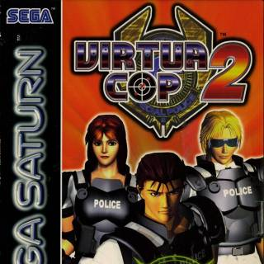
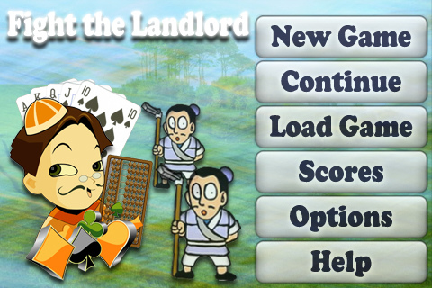
2 years Longitudinal study
Virtual cop2 & Fight Landlord

Slide 6
240 children ( 54% females, 46% males) from two elementary schools in southwest China
Children played each game for approximately 15 minutes
Seven-item scale for assessment
pleasantness, excitement, violence content, violent images, fear, interest, and reality (5-point Likert, 1= very low, 5= very high

Slide 7
results
Virtual Cop2- higher score for violent content
Boys- More pleasant, exciting, interesting, and causing less fear (Virtual Cop2), less interesting for Fight Landlord
Girls- rated VC2 as more violent,
Facial expressions
HA,LA/MA

Slide 8
Prevalence of exposure to violent video games and media among primary school children in Baghdad city
Saba Dhiaa, Waleed A Tawfeeq
” These increased exposures to stereotypic information are likely to influence stereotypic conceptions about gender roles. Boys’ preferred television shows involved more violence than did those of girls (Morgan & Shanahan, 1997) further , Mayer (2003) supposed that girls are more attracted to media programs that allow social interaction, simulation and are less attracted by action-oriented formats which provide less social interaction” (Dhiaa and Tawfeeq, 2014).

Slide 9
What can parents do?
Educational games
Prosocial games
Involve in other activities such as
Drawing, painting, sporting, playing musical instruments

Slide 10
Works cited
"Virtua Cop 2 Similar Games." Giant Bomb. N.p., n.d. Web. 18 Apr. 2017.
"IPhone: Fight the Landlord Card Game." Touch Arcade RSS. N.p., n.d. Web. 18 Apr. 2017.
Jia-Kun, Zheng and Zhang Qian. "Priming Effect of Computer Game Violence on Children’s Aggression Levels." Social Behavior & Personality: An International Journal, vol. 44, no. 10, Dec. 2016, pp. 1747-1759. EBSCOhost, doi:10.2224/sbp.2016.44.10.1747.
Anderson CA and Dill KE. "Video Games and Aggressive Thoughts, Feelings, and Behavior in the Laboratory and in Life." J of Personality and Social Psychology; 2000, 78(4): 772-90.
Morgan M and Shanahan J. "Two decades of cultivation research: An appraisal and meta-analysis." In B. R. Burleson(Ed.), Communication yearbook 1997,20 (pp. 1–46). Thousand Oaks, CA: Sage.
DeWall, C. N., Anderson, C. A., & Bushman, B. J. (2012). Aggression. In H. Tennen & J. Suls (Eds.), Personality and social psychology (pp. 449–466). New York, NY: Wiley.
Gentile, D. A., Lynch, P. L., Linder, J. R., & Walsh, D. A. (2004). The effects of violent video game habits on adolescent hostility, aggressive
Kirsh, S. J. (2003). The effects of violent video game play on adolescents: The overlooked influence of development. Aggression and Violent Behavior, 8, 377–389. http://doi.org/dgcssk

Slide 11
Wallenius, M., & Punamäki, R.-L. (2008). Digital game violence and direct aggression in adolescence: A longitudinal study of the roles of sex, age, and parent–child communication. Journal of Applied Developmental Psychology, 29, 286–294. http://doi.org/bpw6tw

