Slide 1
Approaching Art in Academia
Preparing for Assignment #4

Slide 2
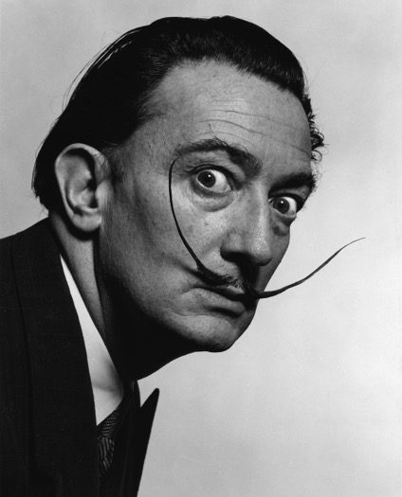





Slide 3
What interests you about art?

Slide 5
Describe using factual information only. Use descriptive language, describe the art to someone who is not looking at it. Count, list, categorize, note shape, color, texture and so on…
Interpret and offer potential meanings or symbolism. Think about how the artist’s design communicates ideas. What is the cultural impact or context?
Evaluate the Art by commenting on the effectiveness of the message. How could the artist improve the design and function? Consider your emotional reaction and express multiple responses.

Slide 7
Describe using factual information only. Use descriptive language, describe the art to someone who is not looking at it. Count, list, categorize, note shape, color, texture and so on…
Interpret and offer potential meanings or symbolism. Think about how the artist’s design communicates ideas. What is the cultural impact or context?
Evaluate the Art by commenting on the effectiveness of the message. How could the artist improve the design and function? Consider your emotional reaction and express multiple responses.

Slide 9
Describe using factual information only. Use descriptive language, describe the art to someone who is not looking at it. Count, list, categorize, note shape, color, texture and so on…
Interpret and offer potential meanings or symbolism. Think about how the artist’s design communicates ideas. What is the cultural impact or context?
Evaluate the Art by commenting on the effectiveness of the message. How could the artist improve the design and function? Consider your emotional reaction and express multiple responses.

Slide 10
Assignment #4 Understanding Place or Artifact: Campus Landscape, Building, or Art
650 words
Pick physical part of campus: building or public artwork
Consider history, importance and appropriateness
Analyze how and why the architect or artist chose to plan and create this particular feature of campus
Include facts in description
Offer your interpretation
Determine how your chosen building or campus artifact was created and placed

Slide 11
Homework:
Read “Old Capitol, 1842” on Moodle as an example of a description of architecture
Watch C-Span’s Iowa State Capitol video- link on Moodle
Determine the campus building or artwork you wish to write about in Assignment #4

