Slide 1
ENGL 150
Week 11 (W) – Fundamentals of Brochures and Posters

Slide 2
Agenda of Today
Wrap-up of the last activity
Fundamentals of Graphic Design (going to be intense!)
Examples for examination

Slide 3
Wrap-up of the last activity
What did you see?
Using our findings, we’ll create a board of “Do’s and don’ts”.
Grab two post-its. On one, write down one thing you should do on a brochure and/or poster (up to you). On the other, write down a “don’t”. Remember, there are just your suggestions.
Attach your post-its to relevant parts of the board.
This think-tank of your ideas will be shared through Moodle.

Slide 4
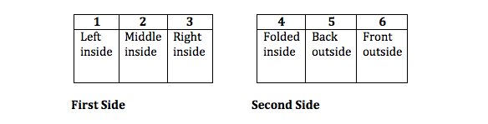
Quick comparison - Brochures
Tri-fold brochures have six panels of design space.
Require planning for stand-alone sections such as the cover flap, as well as planning for how certain interior and exterior flaps will look when viewed together.
Are better for large amounts of text-based information.

Slide 5
Quick comparison - Posters
Have only one large design space on which to create.
Allow for flexibility with photos and graphics because there are no folds to worry about.
Should rely more on visual elements than text to communicate. (Doesn’t mean that it won’t have any text on it.)

Slide 6


Posters
Not too wordy.
Picture has the “message.”

Slide 7
Poster or brochure? Why?
You want to showcase a student organization and explain the group’s purpose, recent activities, and how to join.
You plan to profile the Gold Star Hall in Memorial Union and have more detailed photos than textual elements to work with.
You have equal amounts of visual and textual elements about Reiman Gardens to work with.

Slide 8
Fundamentals of Graphic Design
Three main components:
Composition
Typography
Color

Slide 9
Composition (Vocab)
Design element: One aspect of a design (a photo, a text block, a label or caption, etc.)
Visual hierarchy: the order in which the content in a visual design should be viewed
Chunking: dividing information in small, manageable pieces
Positive space: Any area of a design that appears to have a form or object in it.
Negative space: All remaining space (the background or unused space).

Slide 10
Visual Hierarchy
Determine which element viewers should look at first. What information is most important in the design? It may be text, such as a title, or it may be an image, such as a photo or logo.
Differentiate the most important element from the others in the design by relative size, prominent placement, and/or color.

Slide 11
Visual Hierarchy
To use color to establish visual hierarchy, consider choosing one hue and using several saturation levels of that hue to designate importance.
In the example, font and two saturations of brown are used to guide the viewer through the design.

Slide 12
Chunking
Breaking information into small bits or “chunks” makes it easier for your audience to process and remember
Research suggests that the optimal number of chunks of information for a human to process is no more than nine, some studies suggest as few as four.
Using lines, borders, colors, and shading as dividers between pieces of information is one way to break elements into chunks.

Slide 13
Using positive and negative space
When planning a design, consider both the positive and negative space. Negative space contributes as much to the composition as does positive space.
A lack of negative space can make a design appear “busy” and confusing for the audience.
The two mini examples that follow on the next two slides illustrate both negative space and chunking. The first one is not particularly effective at either concept; the second corrects problems in both areas.

Slide 14
Chunking and Space
The sample is crowded and confusing. Without using the concept of chunking, it is difficult for readers to determine which photo a text block is referring to. Space is not used effectively here either. Some areas are open with a lot of negative space, while other elements are too close to each other.

Slide 15
Chunking and Space
This design uses many of the same elements as the previous sample, but the elements are arranged with the principles of chunking and negative space in mind. Lines and colored boxes are used to help the viewer understand which elements are directly related to each other. This example also utilizes the idea of visual hierarchy discussed earlier to guide the viewer through the design.
Anything wrong with this one?

Slide 16
Photo Considerations
Consider how large a photo will be in the finished product before using it. Small photos with a lot of detail may not be the best choice for a standard size brochure, but may be more effective in a poster.
Choose photos that are focused and clear. Nobody likes a fuzzy photo!
Utilize basic photo editing functions, such as cropping, to make a photo as effective as possible. The same photo can make different impressions based on how loosely or tightly it is cropped.

Slide 17
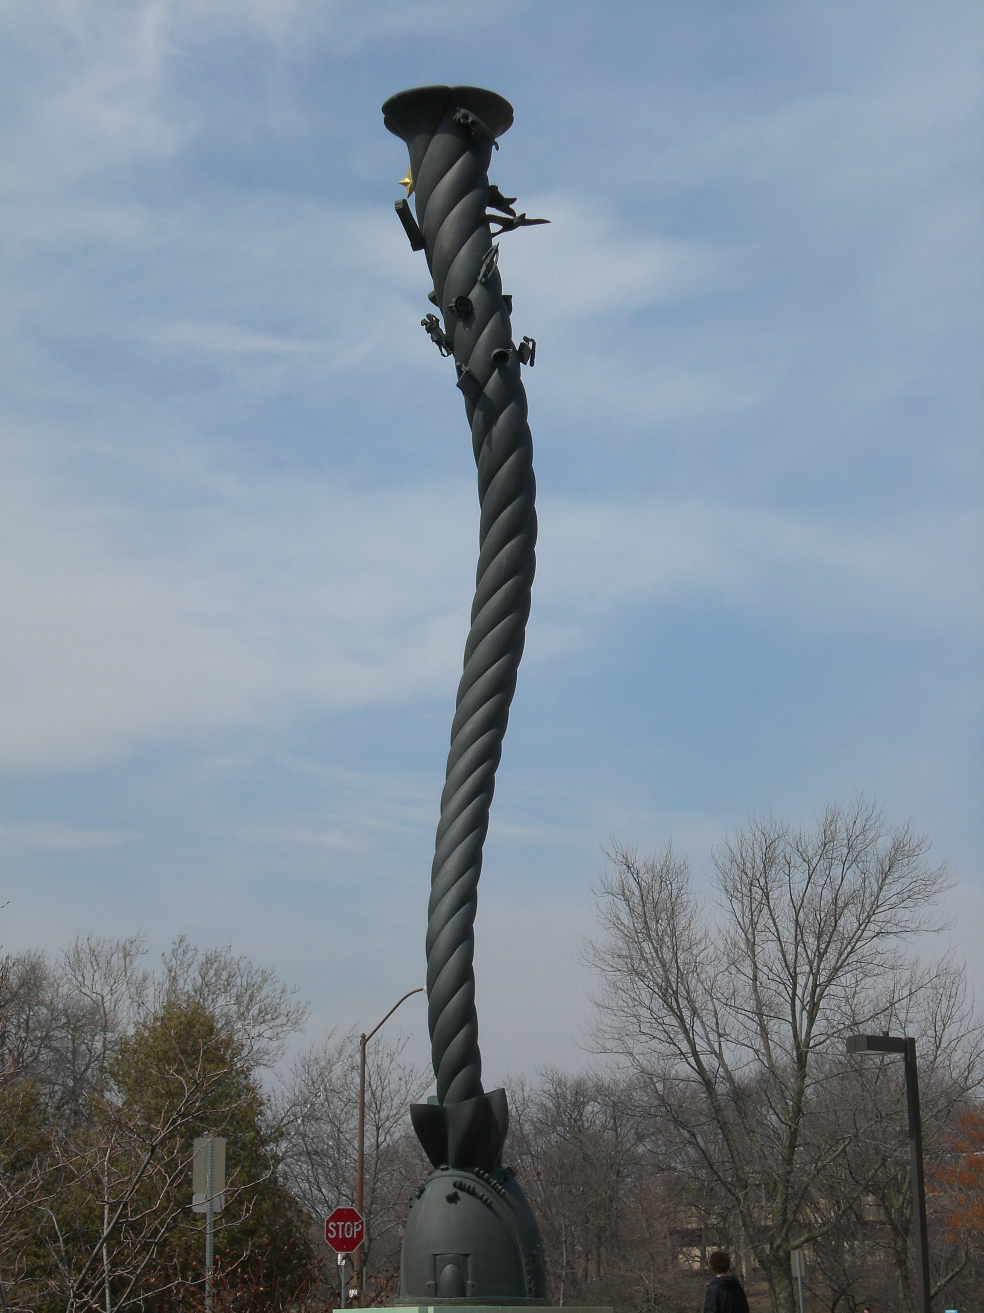

Photo Examples - Cropping
The photo above has not been edited at all. It is a wide shot with several unnecessary and distracting details.
Now that this image has been cropped to remove the stop sign and pedestrian, the focus is fully on the sculpture.

Slide 18

Photo Examples – Detail
This tightly cropped image from the previous slide allows viewers to see the entire sculpture. However, it would be difficult for a reader to appreciate the details at the top of the sculpture, especially in a brochure.
In contrast, this photo does not give viewers the same perspective about the whole work of art, but would allow them to see the details of the objects “stuck” in the cyclone.

Slide 19
Mini Quiz!
Name 2 of the the elements of composition.
True or false. A good design tries to fill as much of the space as possible with design elements.
What is the term for breaking information into small, manageable bits?

Slide 20
Typography (Vocab)
Typeface: The style of a particular group of letters. (Times New Roman)
Font: All of the characteristics about a typeface in a given design. (Times New Roman 22pt bold)
Serif : The small lines on the edges of letters in typefaces such as Times New Roman and Baskerville.
Sans serif: Typefaces that do not have serifs such as Arial or Geneva.
Legibility: the degree to which something is easy to read

Slide 21
Legibility
The most important consideration for typeface choice is legibility. If your audience cannot read the text, they will not understand your message. Some typefaces that are legible in small quantities, such as for titles, become less so when used in large quantities, such as for a block of body text. In the examples below, Papyrus is a legible typeface for a short title, but is more overwhelming when used in a longer block of text.

Slide 22
Legibility
The most important consideration for typeface choice is legibility. If your audience cannot read the text, they will not understand your message. Some typefaces that are legible in small quantities, such as for titles, become less so when used in large quantities, such as for a block of body text. In the examples below, Papyrus is a legible typeface for a short title, but is more overwhelming when used in a longer block of text.
This bronze sculpture is located near the south entrance of Memorial Union, just off of Lincoln Way. Created in 2008 by artists Andrea Myklebust and Stanton Sears, this cyclone has several meanings; it is a representation of Iowa State University’s athletic nickname and is also a visualization of the flurry of activity that college often is.
Whirlwind

Slide 23
Creating Contrast
Do combine typefaces, sizes, and weights to differentiate between text elements and to create emphasis.
Don’t combine typefaces simply to add variety. It is tempting to do with the sheer number of typefaces available, but it will not add much to your design if it is done without a reason.

Slide 24


Creating Contrast
Typefaces that are different, but too similar create confusion. This leaves your audience wondering are they actually different or do they just look different?
Combining a serif and a sans serif is a good way to create contrast.

Slide 25
Color (Vocab)
Primary colors: these colors are used to make all other colors, they cannot be made by mixing other colors (red, blue, and yellow)
Secondary colors: colors made by mixing two primary colors (orange, green, and violet)
Tertiary colors: colors made by mixing one primary color and one secondary color, such as yellow-green
Hue: the generic name of a color (red)
Tone: how light or dark a color is, adding white is a tint, adding black is a shade

Slide 26
Color
Analogous colors: colors next to each other on the color wheel (blue and violet)
Complementary colors: colors opposite each other on the color wheel (yellow and violet)

Slide 27
Color – Things to consider
Warm colors can make a design element appear to advance, while cool colors can make an element appear to recede.
Using these color cues can put emphasis on some elements of a design or draw attention away from others.
The same color used more than once in a design can appear different depending on the other colors near it.
Placing complementary colors near each other creates contrast, while using analogous colors together creates visual harmony.

Slide 28
Color – Creating contrast
Using a high level of contrast between the colors of the text and the background makes it easier for the audience to read. The examples use the same hue and tone on the text, but the upper example has a lower level of contrast than the lower one, making it more difficult to read.

Slide 29
Color – Choosing a color scheme
Consider using no more than three hues in your design.
You may want to use cool colors for the background and warm colors for the foreground.
Colors that are light in tone and neutral tend to work best as background.
If you use very bright and intense colors, use them sparingly!

Slide 30
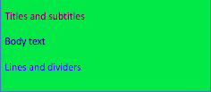
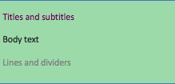
Color scheme – what do you think?
Notes:
Color scheme number one could be described as fun, but it is too intense for this type of project. Using an intense shade of lime as a background is distracting for your audience; it may grab their attention, but not in the best way. Color scheme number two actually uses the same base hues, but tones down several of them to give a more professional look. The second one uses three base hues (green, violet, and gray) and uses two saturations of gray for added variety

Slide 31
Activity
Open Moodle. Find the folder “Poster & Brochure Examples” under week 11. There, you will find one brochure and two poster examples.
Discuss each example with a partner, paying attention to the things that we have talked about so far, particularly:
  Composition: Hierarchy, chunking, positive/negative space, pictures
  Typography: Font, legibility, contrast
  Colors: Color choices, contrast in colors
Be ready to share with the whole class: You will argue whether the choices made in that example are effective or not from your point-of-view.

